Slide 1
Knutsen Group
Presentation
Steadily forward.

Slide 2

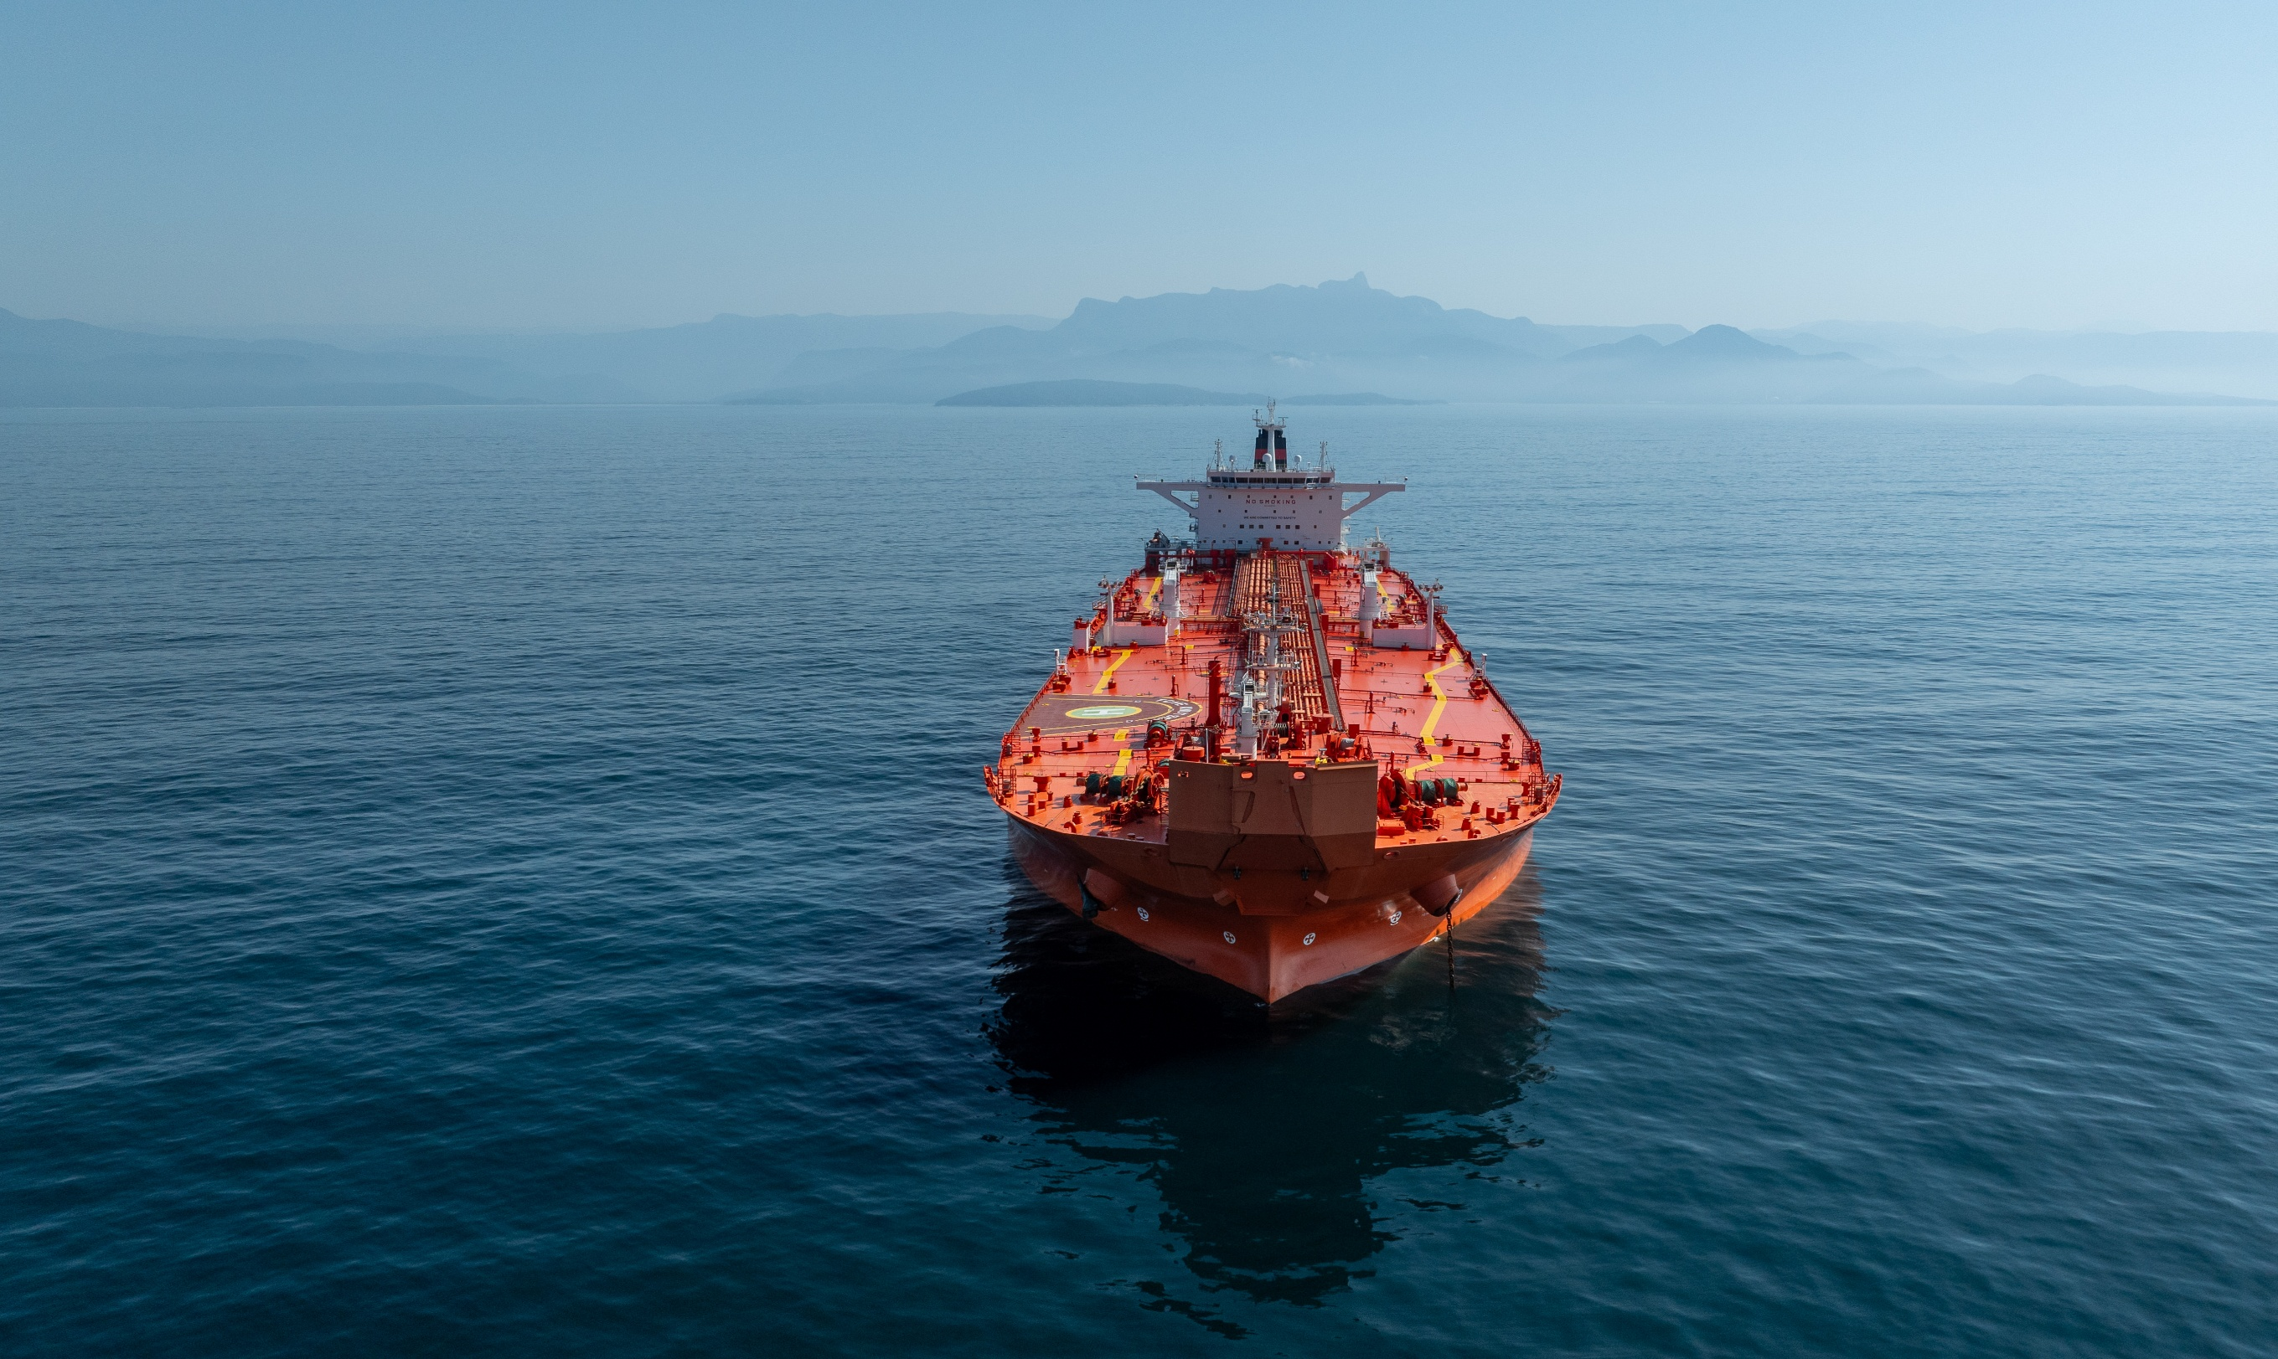
technical and commercial operation chartering building supervision
Knutsen provides top tier
maritime solutions
for global energy
sector.

Slide 3






MARITIME TRANSPORTATION
Integrated Shipping
Group
32 + 9 LNG carriers
3 Small scale LNG bunker supply​
    30 + 8 shuttle tankers
1 FSU / FSRU design
MARITIME TRANSPORTATION
TECHNOLOGY
SERVICES
​2 floating storage & offloading (FSO) vessels​
Private company (KNOT)and public company (KNOP)listed NYSE

Slide 4

TECHNOLOGY & SERVICES
Integrated
Shipping
Group
Knutsen New Energy
37,5% Deep Wind Offshore
Ship conversion & design
Well stimulation
VOC Emissions reduction; KVOC®
Extended well testing
MARITIME TRANSPORTATION
TECHNOLOGY
SERVICES
Knutsen Ballast Water Treatment System: KBAL®
Full in-house management
Knutsen NYK Carbon Carriers: KNCC
Transportation of CO₂ compressed natural gas
Knutsen PNG® & Knutsen PCO2
Operation
Building supervision Chartering
Project development

Slide 5
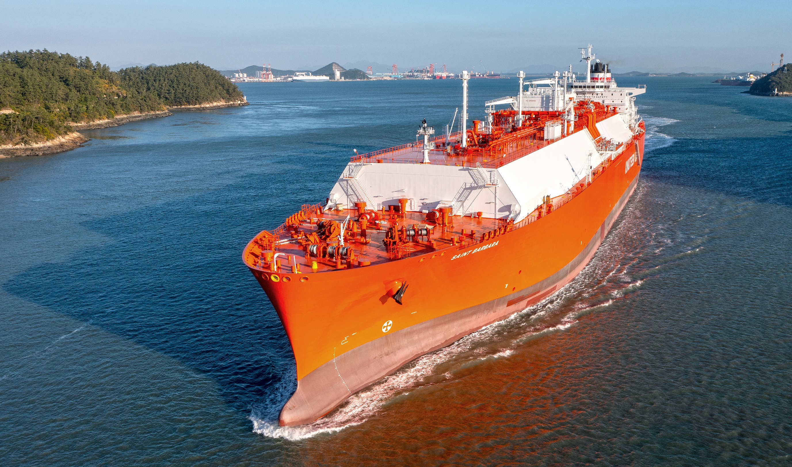
technical and commercial operation chartering building supervision
About us

Slide 6
1896
Knut Knutsen O.A.S. (Ole Andreas’ Son) established
1930-1970
Developed into Norway’s third largest tanker owner
Timeline
1894 -2024
1980-1987
Technical Director Mr. Trygve Seglem became part owner.
The Knutsen Family and Bergen Bank sold their shares, Mr. Ulltveit-Moe and Mr. Seglem became owners.
Restructuring early 1980s.
1984
Knutsen OAS Shipping AS is established.
1987
Delivery of the first two Knutsen shuttle tankers
2001
Awarded the first two LNG contracts.
2004
Delivery of the first four LNG vessels.
2008
Jens Ulltveit-Moe’s shares in shuttle-, production- and chemical tankers purchased by Trygve Seglem.
2010
Knutsen joined forces with NYK to establish KNOT
2013
KNOP MLP structure listed on NYSE
2013-2021
KNOT taken delivery of 14 shuttle tankers
Completed conversion of Hanne Knutsen
KNOP growth from 4 vessels to 18 vessels
LNG delivery of 6 vessels
KBAL received USCG and G8 IMO Type Approval
2022-2024
World leading shuttle tankers operator
LNG deliveries of 14 vessels
The LNG segment grown to 29 +14 vessels
Projected increase in marked share, revenue, employment and profit
Sold the last product tankers Liv Knutsen and Eli Knutsen

Slide 7
Knutsen OAS
(UK) Ltd.
ABERDEEN
Head office,
KOAS and KNOT
HAUGESUND
KNOT Management
Denmark AS
COPENHAGEN
SA Knutsen Eastern Europe
RIGA
KNOT Offshore
Partners LP.
LONDON
Knutsen
Philippines Inc.
MANILA
Knutsen OAS
España S.L.
MADRID
Canship
Ugland Ltd.
ST. JOHNS
Knutsen LNG
France SAS
NANTES
KNOT Management
do Brasil Ltda.
RIO DE JANEIRO

Slide 8
STRONG TEAM AT SEA & ASHORE
Onshore Staff: ~ 237
Seafarers: ~ 2769
Updated 09/2025

Slide 9
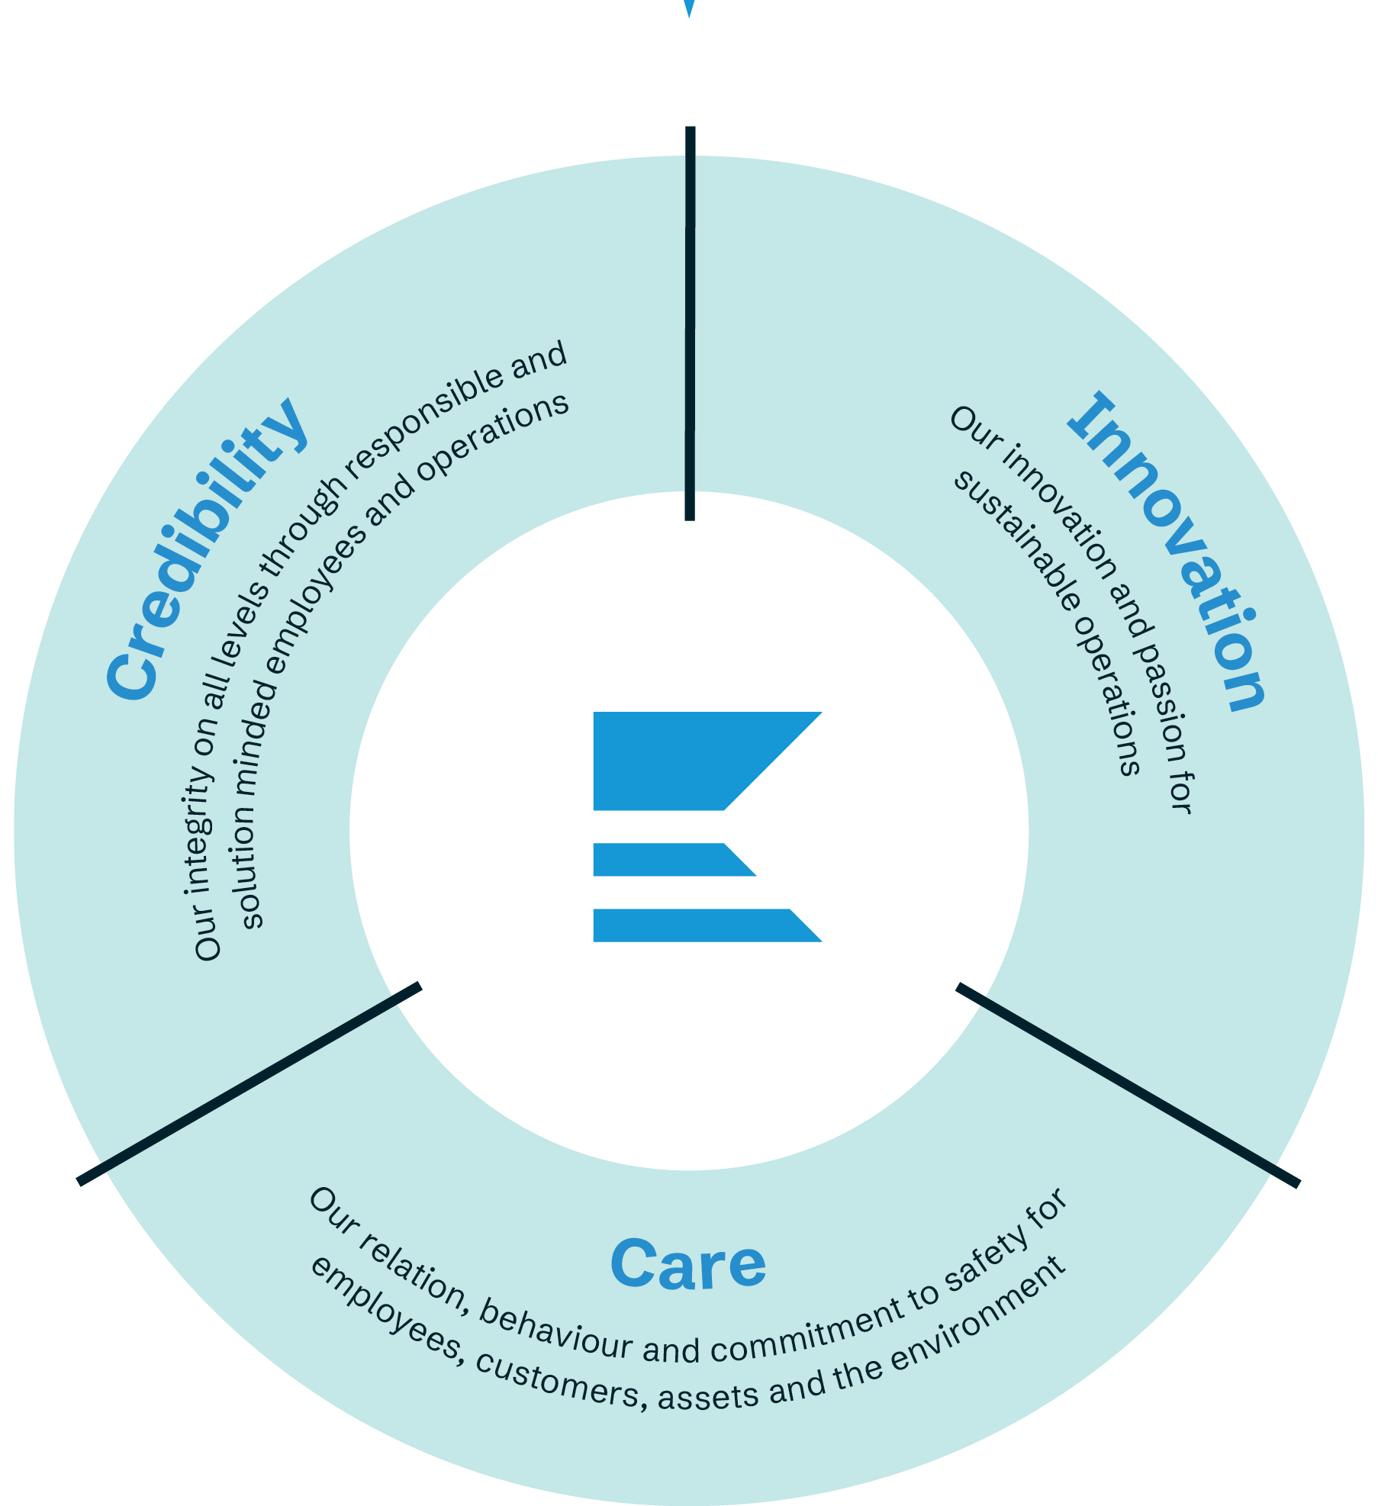
Our values
Our values are essential for us to succeed over time in a competitive environment. Our values are at the core of our management system. They drive our performance. They guide us in how we do business and how we work together and towards stakeholders.
We shall all be committed to our values, in words and in action. Together we will take Knutsen Group to the next level and into a sustainable future.

Slide 10




4 PILLAR STRATEGY
ADVANCED
VESSELS
LONG TERM
CONTRACTS
FIRST CLASS
CHARTERERS
SAFETY COMMITMENT

Slide 11
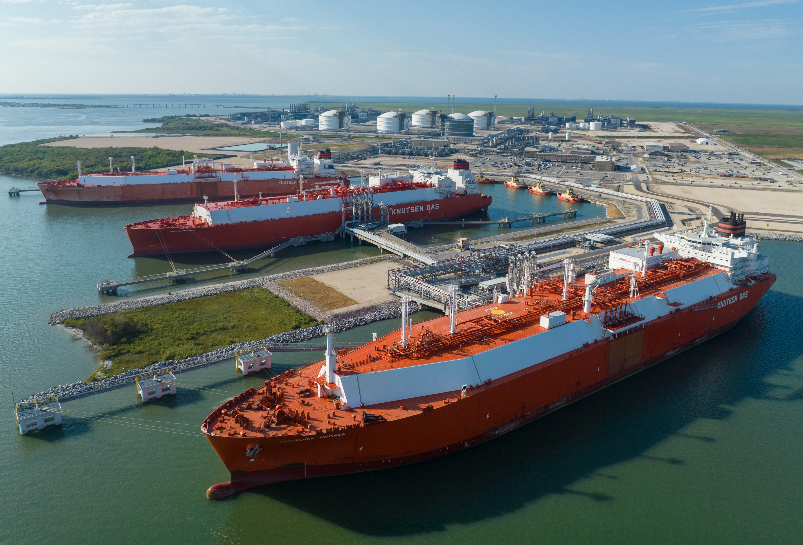
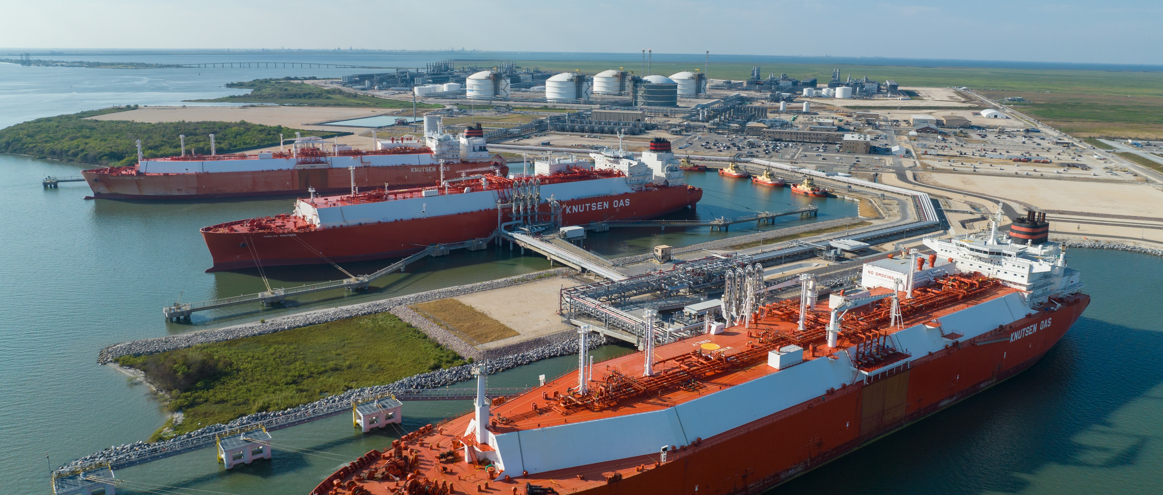
Ensure flawless operation of vessels on longterm contracts
Ensure flawless operation of vessels on long term contracts

Slide 12
Advanced Vessels
LNG Fleet Overview
Fleet of 32 LNG vessels with an average age of 7 years .
The newer vessels are equipped with ME-GI or XDF/ ME-GA engine configurations and full re-liquefaction capacity.
Shuttle Tanker Operations
As the world’s largest shuttle tanker operator, the company operates 30 vessels. Of these, 19 vessels are owned by Knutsen NYK Offshore Partners (KNOP), a US stocked listed Master Limited Partnership (MLP).
The KNOP shuttle tanker fleet has an average age of 10 years, and all vessels are equipped with DP2 (dynamic positioning systems).
The fleet maintains a strong operational track record, with consistently low levels of technical off-hire.
Long-term Contracts
Knutsen managed fleet has USD 12 bn of firm backlog and USD 12.3bn of optional backlog.

Slide 13
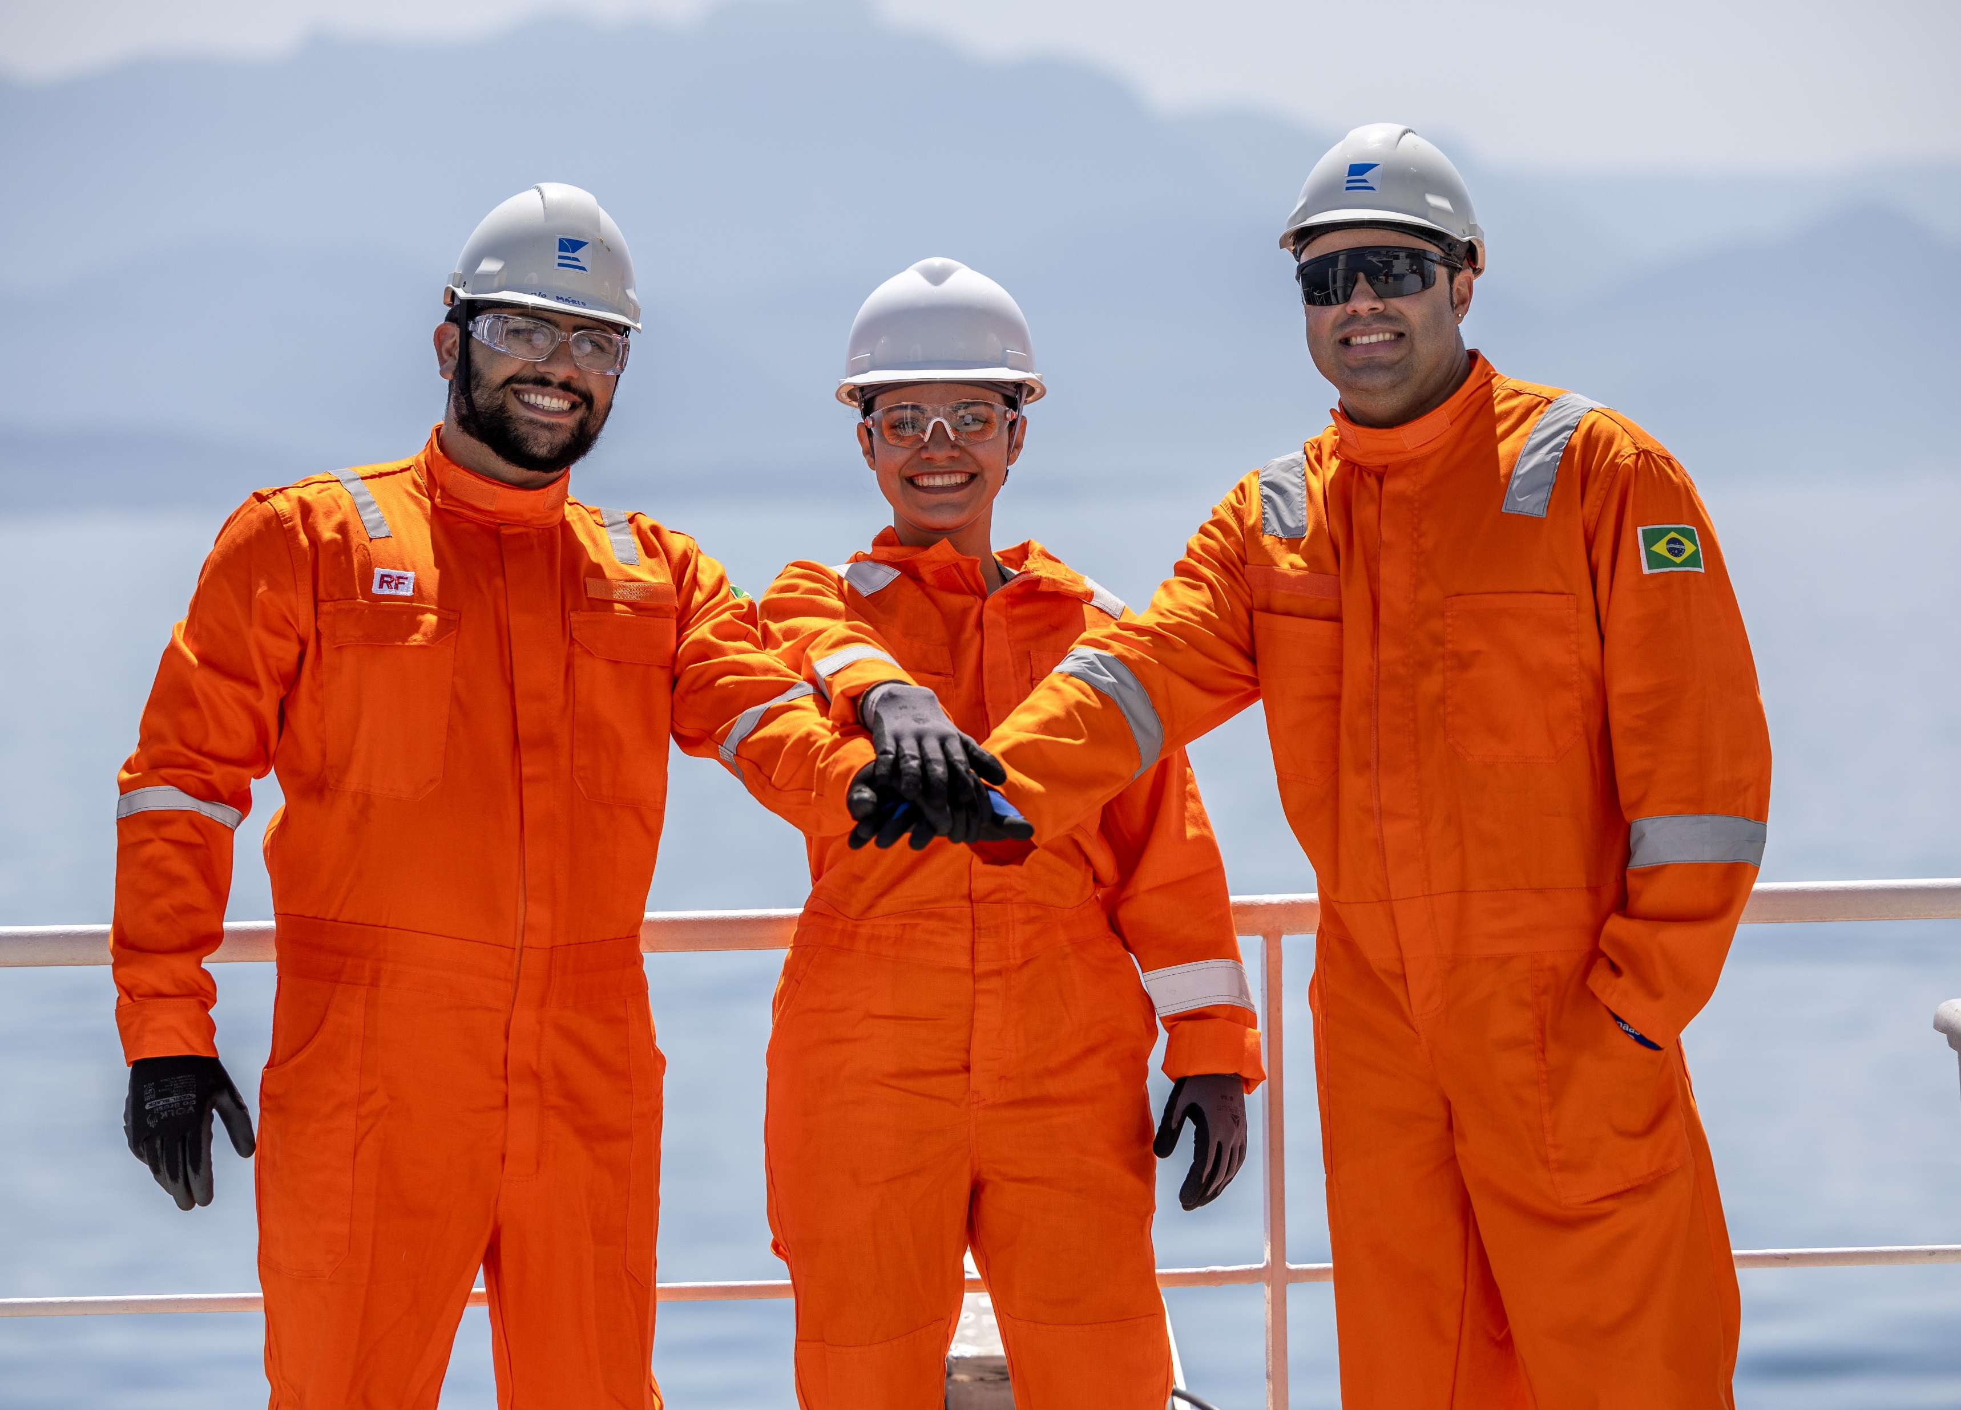

Safety
Commitment

Slide 14
Safety program
KPIs | 2020 | 2021 | 2022 | 2023 | 2024
LTI frequency | 0,23 | 0,44 | 0,33 | 0,65 | 0,27
Total recorded cases frequency | 1,86 | 1,43 | 1,76 | 2,13 | 1,88
Sick Leave | 1,53 % | 3,12 % | 2,65 % | 2,14 % | 2,14 %
Average vetting observations related to vessel | 1,22 | 1,51 | 1,11 | 1,19 | 0,67*
ECO care actions | 1445 | 1238 | 1330 | 1648 | 1487
Environmental requirements training
Personal safety involvement training
Management behaviour training
Focus on lessons learnt
Familiarization training
Near miss reporting
Risk assessment – Toolbox Talk – Time Out
Root cause investigation training

Slide 15





Environmental,
Social Governance
Knutsen has strong focus on contributing to more energy efficient and environmentally friendly vessels. Both LNG carriers and shuttle tankers in our newbuilding program are state of the art
Eco-care program encourages emissions reduction on vessels in operation
We are responsible for a safe working environment onshore & onboard of all our vessels
We have been partners in Maritime Anti-Corruption Network since 2015
Total 43% women in our offices

Slide 16
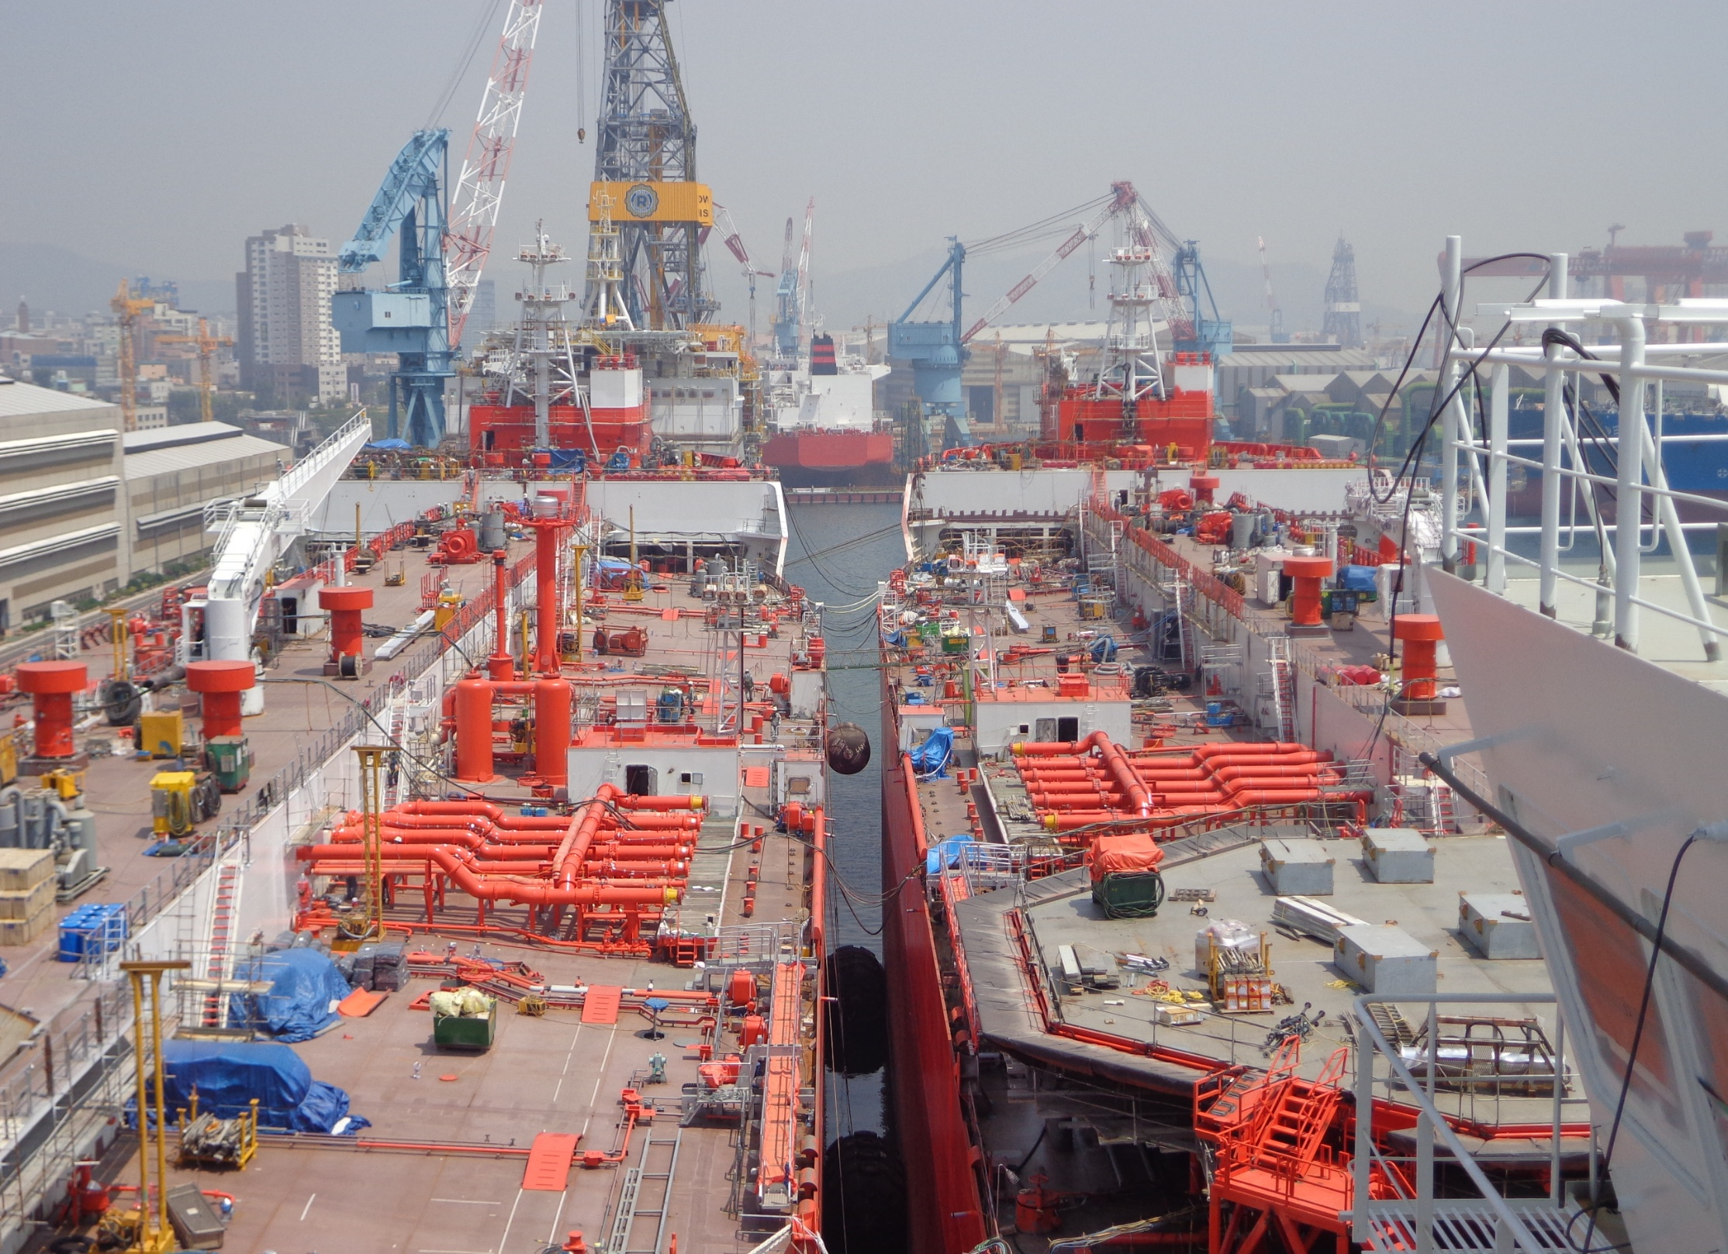
92 BUILT VESSELS
1987 – 2025
AVERAGE 2,4 VESSEL BUILT PER YEAR
40 shuttle tankers + 7 new buildings under construction
14 product / chemical tankers
37 LNG/c + 6 new buildings under construction
1 oil tanker

Slide 17
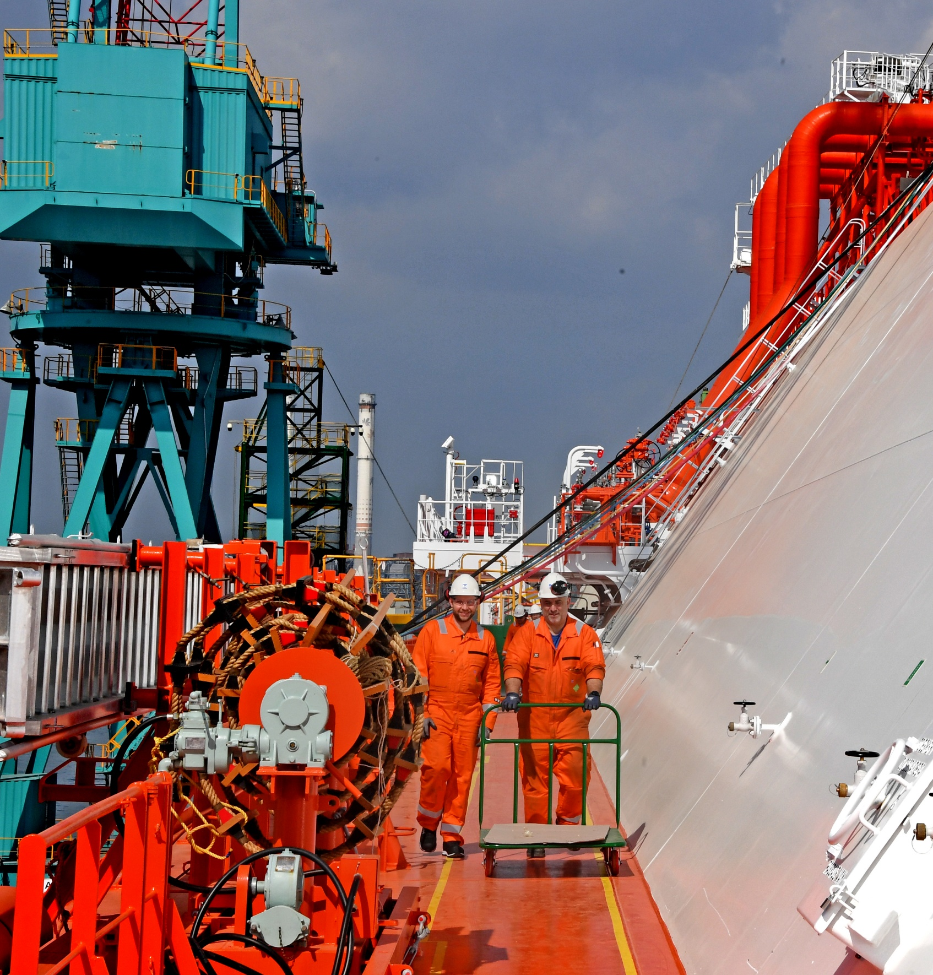
Operations
Excellent Experience
35 years in offshore loading & DP operations, more than 5000 cargos
6 STL ships (2 operating for 19 years)
26 BLS ships (bow loading system)
30 years in offshore tandem loading
FSO loading from two independent production platforms simultaneously
22 years of FSO operations
Operating in icy and harsh weather conditions
Largest operator of handy size shuttle tankers
Support vessels for extended well testing
18 years LNG/c operations
100+ successful LNG ship to ship transfers
World smallest operating LNG feeder/ bunker vessel

Slide 18
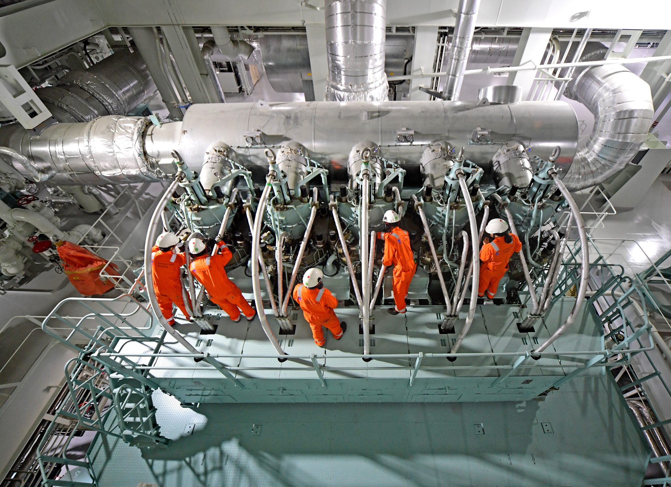
Operations
Pioneered by Knutsen
First STL on shuttle tankers
First shuttle tanker with diesel electric propulsion for Norwegian shelf
First operator of VOC recovery unit on shuttle tanker

Slide 19
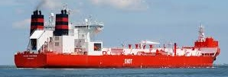


A significant shipping group: turnover and EBITDA of total fleet
(USD m) | 2020 | 2021 | 2022
Operating income¹⁾ ²⁾ | 847 | 880 | 1 017
Operating costs ²⁾ | (257) | (320) | (391)
EBITDA | 590 | 560 | 626
Knutsen Group – stable earnings and
EBITDA despite volatile couple of years
Knutsen Group 2022 EBITDA split per business unit
Shuttle 2022 (USD m)
Operating income¹⁾ ²⁾ | 612
Operating costs ²⁾ | (292)
EBITDA | 320
LNG 2022 (USD m)
Operating income | 397
Operating costs | (96)
EBITDA | 301
Prod / Chem 2022 (USD m)
Operating income | 9
Operating costs | (5)
EBITDA | 4
+
+

Slide 20
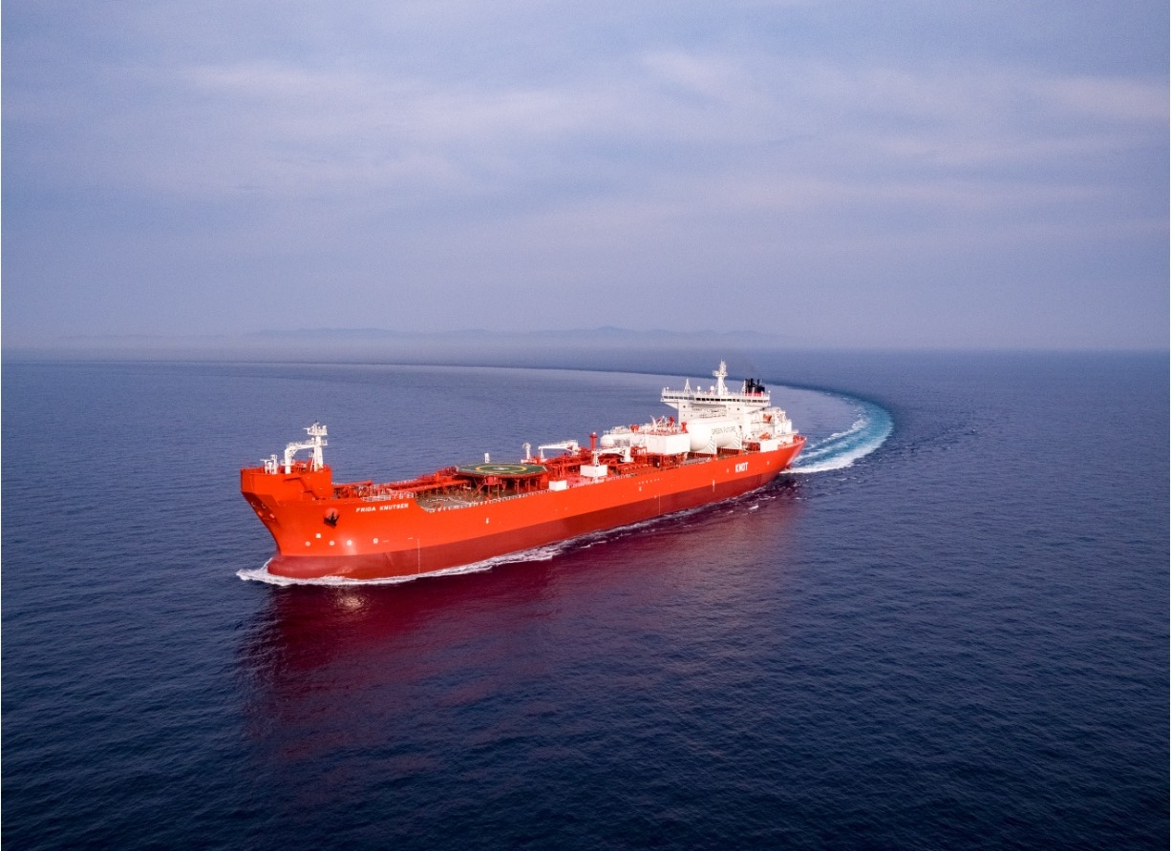
Knot is the world’s largest DP shuttle tanker owner & operator
30 vessels including
28 shuttle tankers
2 North Sea FSOs in operation since year 2000 and 2018 respectively
8 NB Shuttle tankers

Slide 21
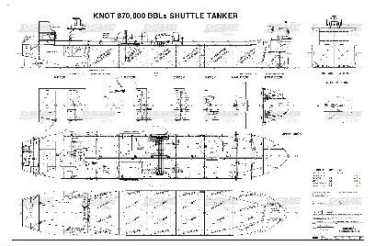
Shuttle Tankers for ENI
Low emission Shuttle Tanker
2 X WinGD 6X52Dual Fuel Main Engines
VOC/LNG fuel gas supply system with one (1) IMO Type-C LNG fuel tank and VOC recovery system with one (1) IMO Type-C LVOC tank
One Boiler designed to burn HFO, LSMGO, FG, SVOC and vaporized LVOC
One Turbo Generator capacity of 3,6MW
2 X 350 kWh battery packages for peak shaving

Slide 22
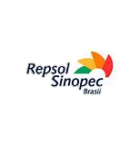
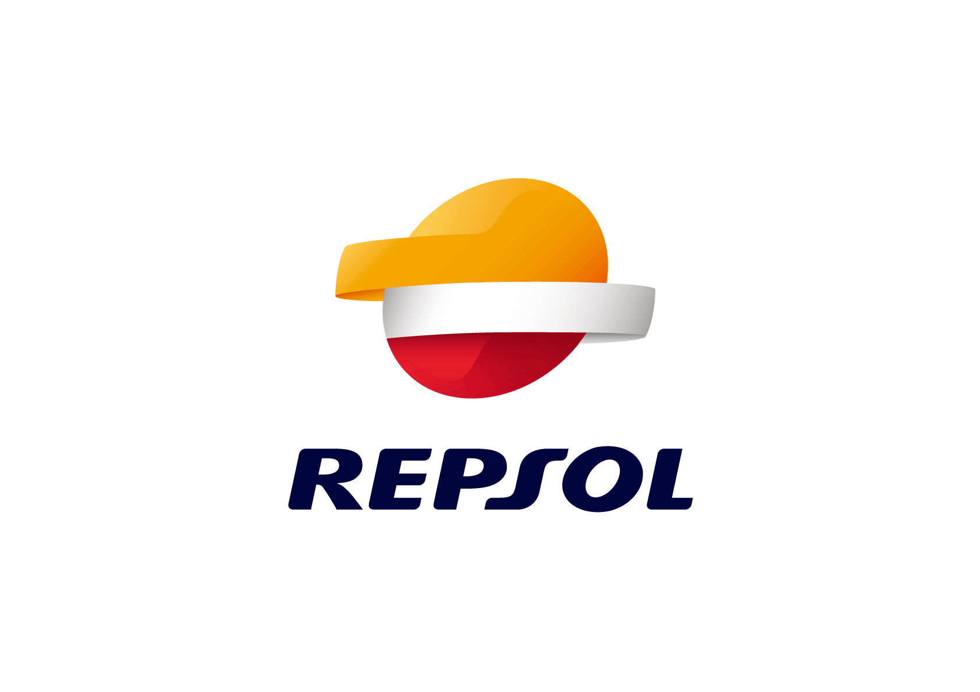





















FOCUS ON SAFETY by oil companies and authorities:
Personal vetting
Routine vetting
Strict reporting and documentation standards
DP qualifications
FIRST CALSS CHARTERING
Charter dependence on shuttle tankers for cash flow:
Many shuttle tankers are operating at designated offshore fields under long-term charter agreements.
Delays or operational issues impact directly earnings of
oil companies
HIGH BARRIERS to entry:
Difficult to enter the shuttle market without prior experience and knowledge
Significant «economy of scale» in CoA operations, making it challenging for smaller players

Slide 23
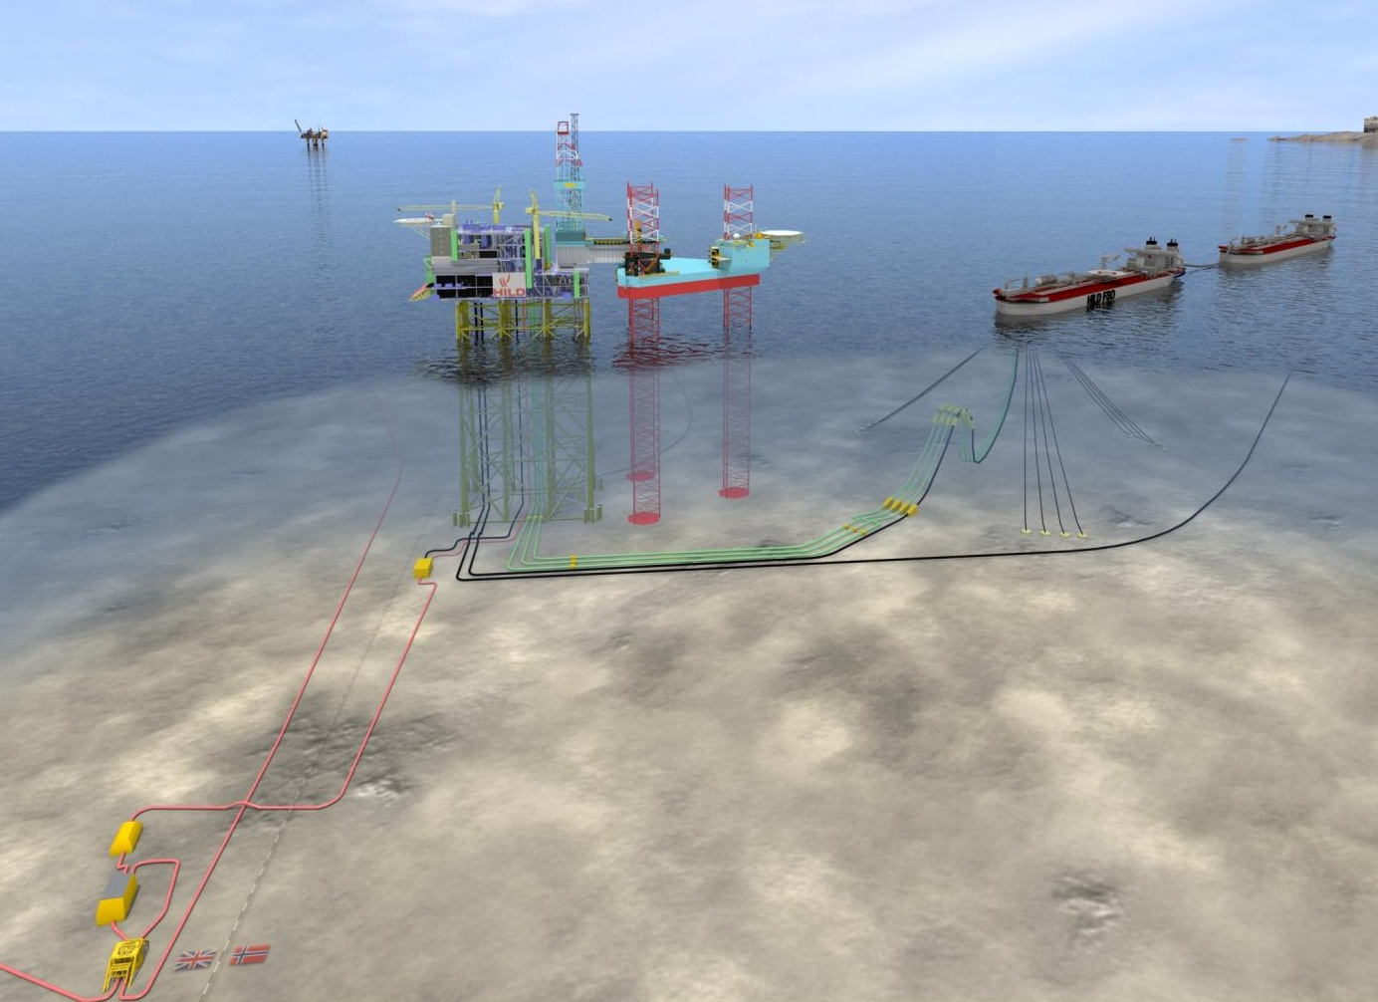
Martin Linge FSO
Conversion of shuttle tanker Hanne Knutsen to FSO
Delivered 2018

Slide 24
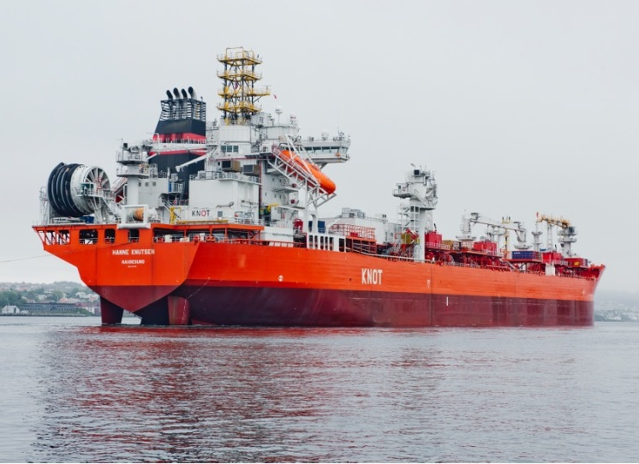
Martin Linge FSO
Major complex conversion project
Submerged turret loading system,
multiple path swivel
Oil/water separation
11 kV power cable from shore, 5 MW
Fuel gas/blanket gas system
Produced water return to production platform
Offshore crane
Cargo tank crude storage capacity:
Approx. 94 000 M3
Offloading capacity: 8000 M3/hr

Slide 25
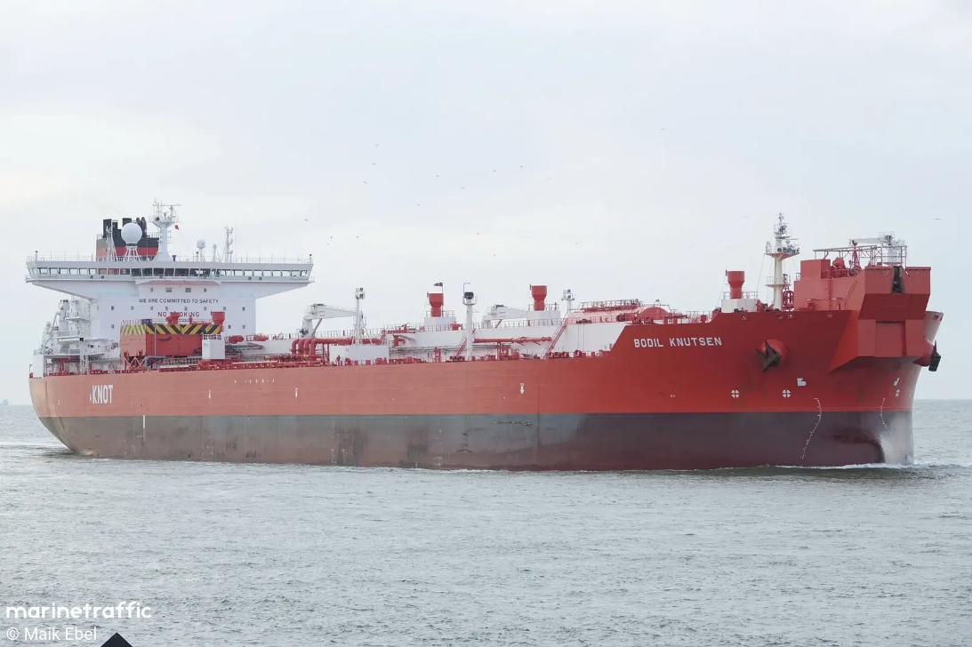
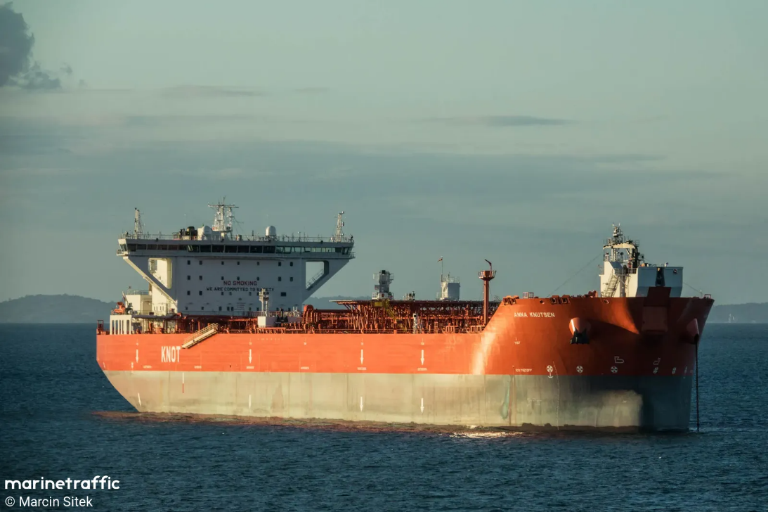
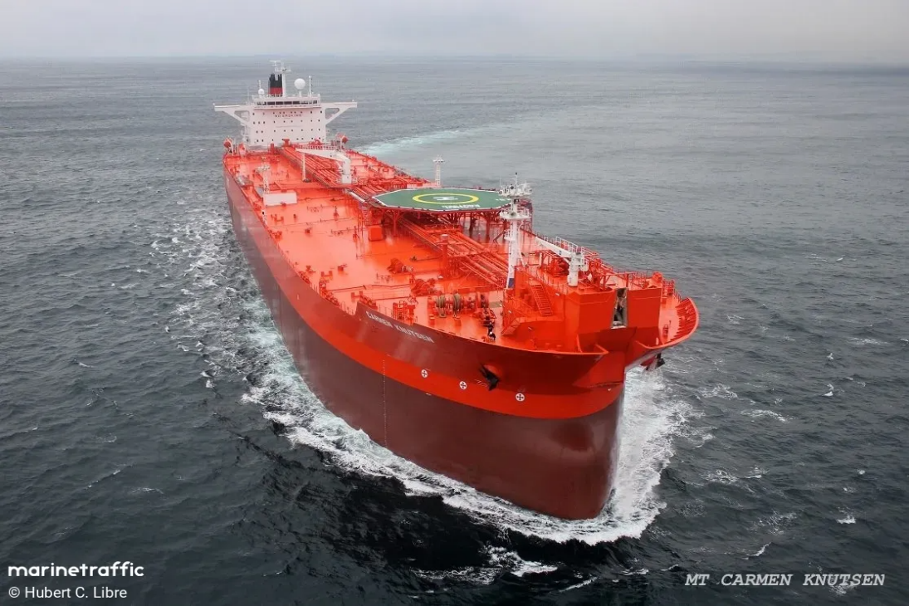
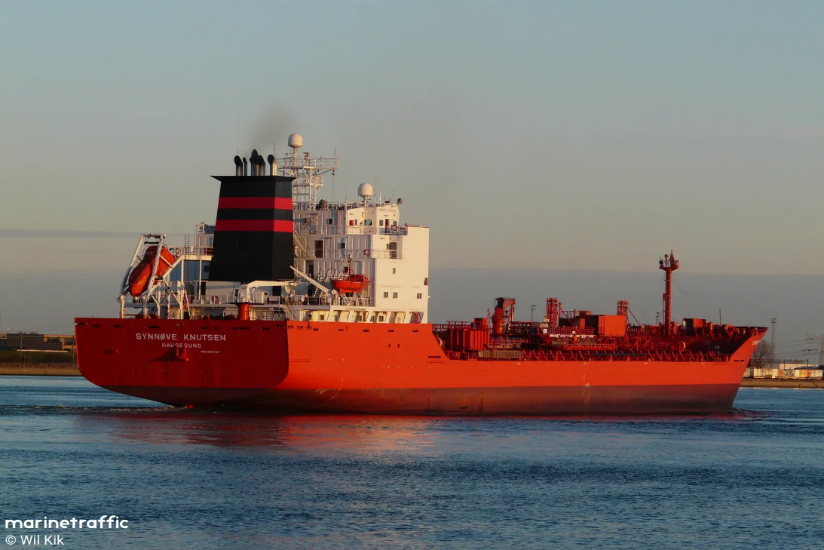
KNOP – Knutsen NYK Offshore Partners (MLP)
IPO April 2013, fleet of four vessels
18 state of the art advanced shuttle tankers, average age 7.8 years vs. Industry average of 7.9 years excluding KNOT fleet
KNOT holds approx. 30% of shares.
All vessels secured under fixed-fee revenue contracts with leading oil majors
Strong outlook for the shuttle tanker business
Annual distribution currently $2.08, yielding 11.3% with share price $18.50

Slide 26
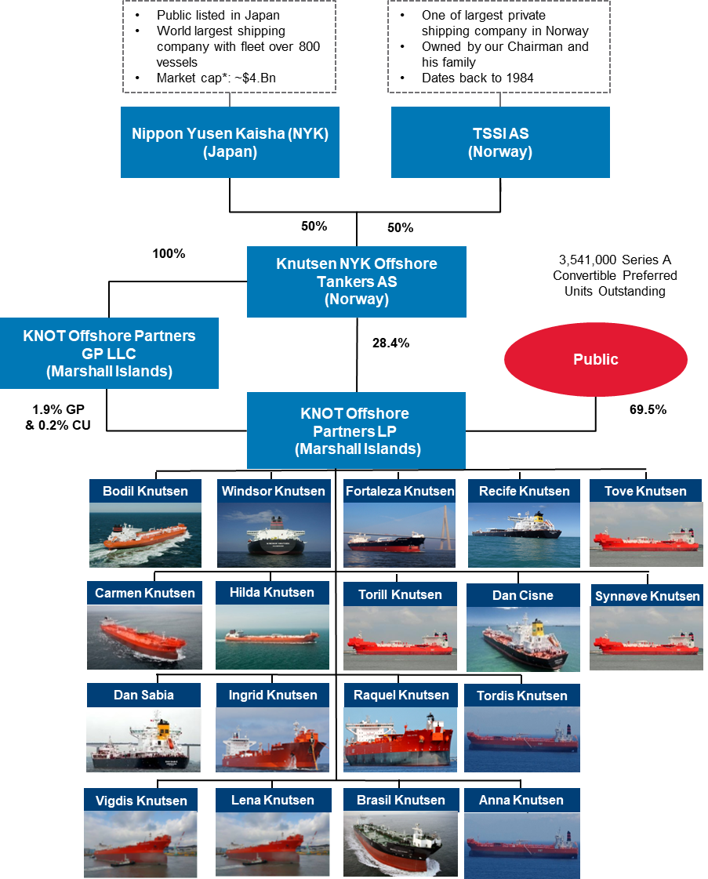
MLP structure, listed 10.04.2013
IPO April 2013, fleet of four vessels
A fleet of eighteen state of the art advanced shuttle tankers, average age 7.8 years vs. Industry average of 7.9 years excluding KNOT fleet(1.1.20)
All vessels secured under fixed-fee revenue contracts with leading oil majors
Strong outlook for the shuttle tanker business
Annual distribution currently $2.08, yielding 11.3% with share price $18.50

Slide 27
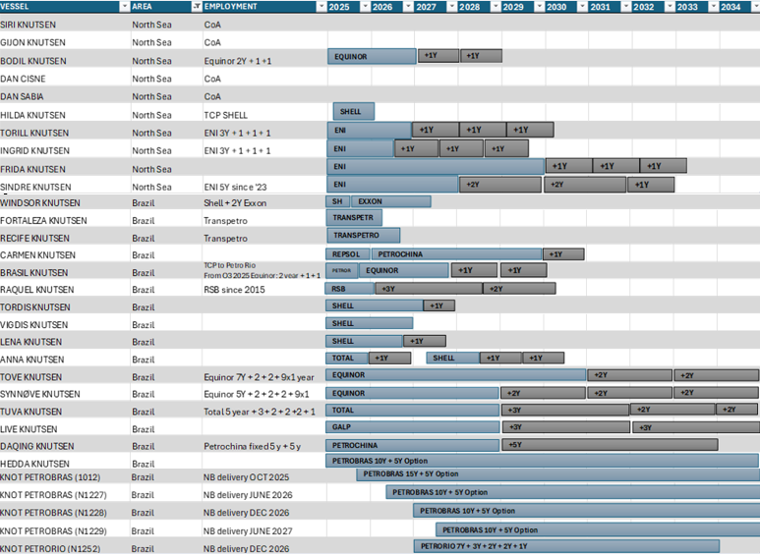
KNOP & KNOT LONG- TERM CONTRACTS
Notes:
Missing
KNOT Repsol 1341
KNOT Equinor 1340

Slide 28
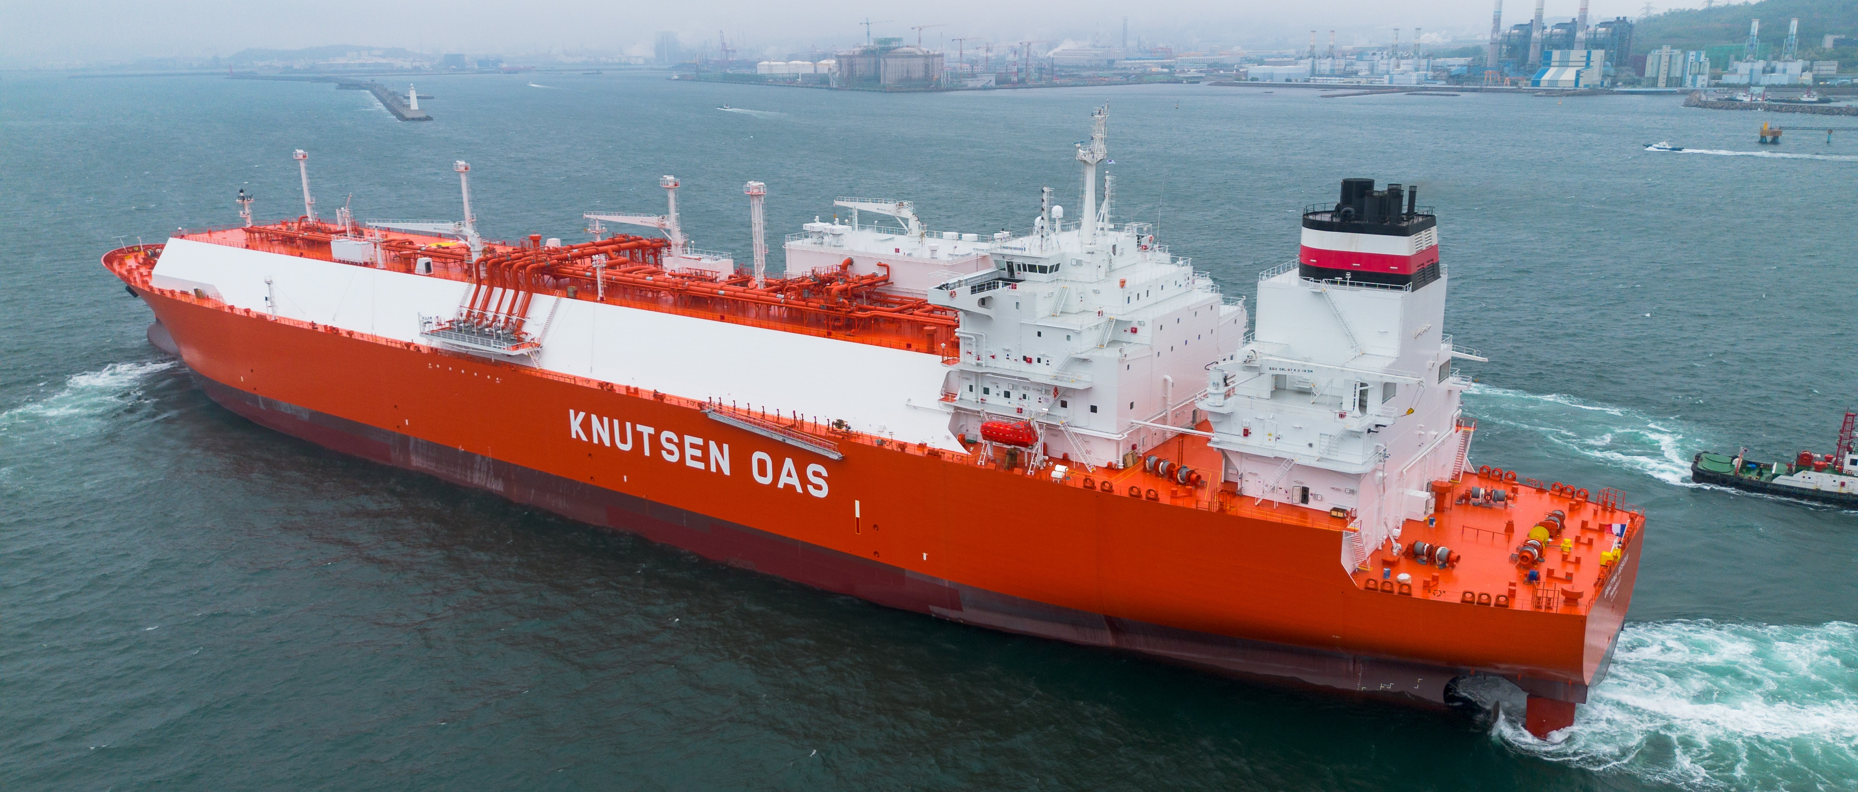
LNG Fleet

Slide 29
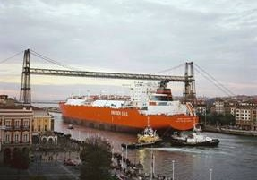
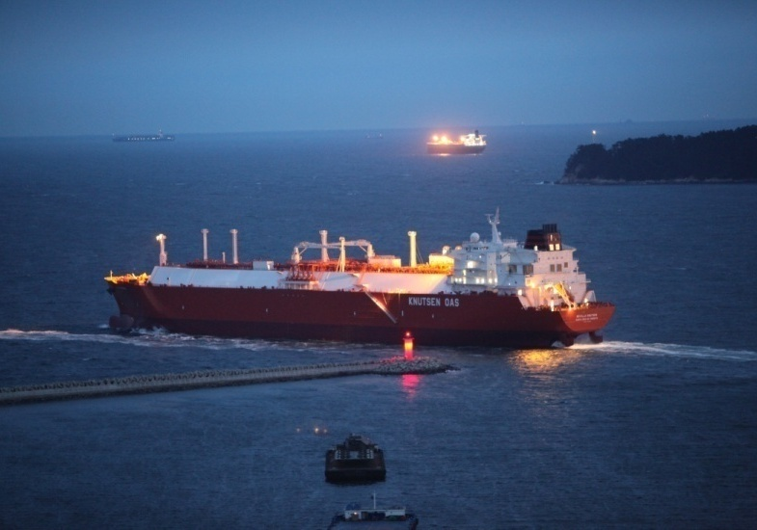
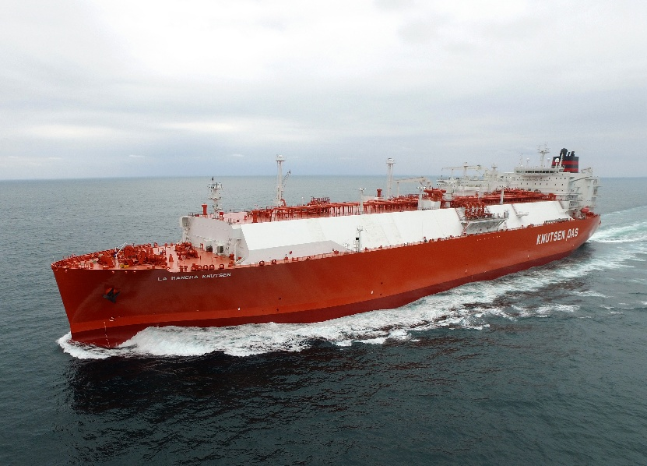
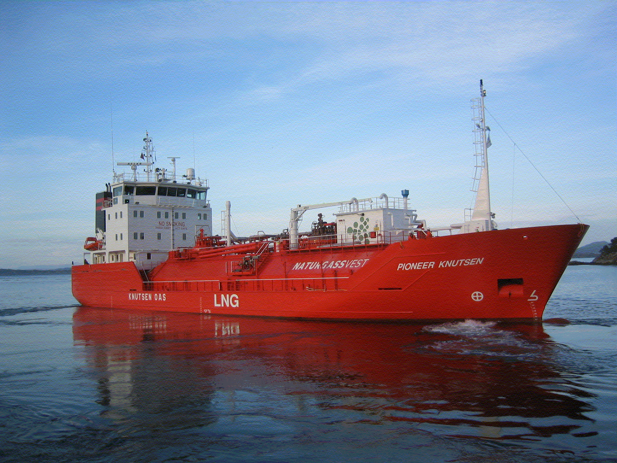
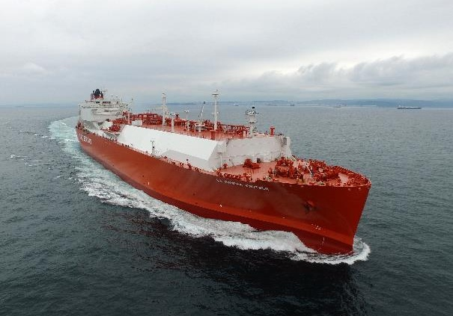
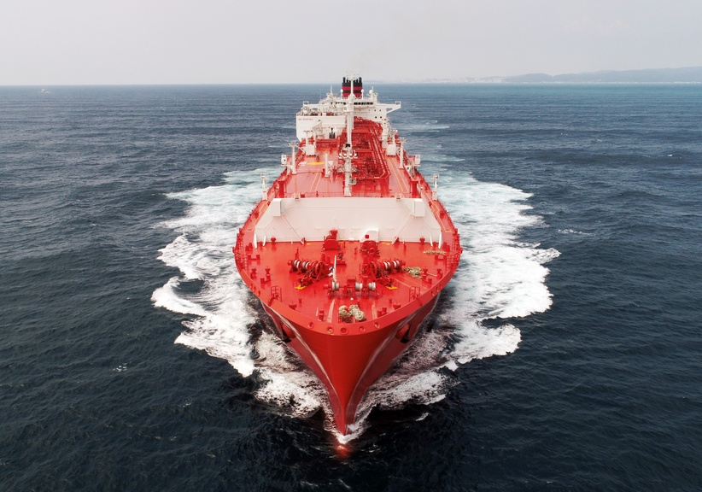
Major LNG operator
32 LNG vessels in operation with a 7 years average age, including:
3 Small scale LNG bunker supply
1 FSU/FSRU design
9 NB delivery in 2025 and 2026
2004
4 x 138 000 M3 LNGc’s (NO 96) Steam turbine
2010
4 x 173 400 M3 LNGc’s (NO 96) TFDE
2016
2 x 176 300 M3 LNGc’s (Mark III Flex) ME-GI, Full reliq., Shaft gen.
2004/21/22
1 x 1 100 M3 LNGc (IMO Type C)
1 x 30 000 M3 LNGc (IMO Type C)
Feeder/ Bunkering vessel
1 x 5 000 M3 LNGBV (IMO Type C)
2019
3 x 180 000 M3 LNGc’s (Mark III Flex)
ME-GI , Full reliq.
2022/23/24/25/26
27 x 174 000 M3 LNGc’s (Mark III Flex)
XDF (9 ME-GA), Reliq., Shaft gen., ALS

Slide 30
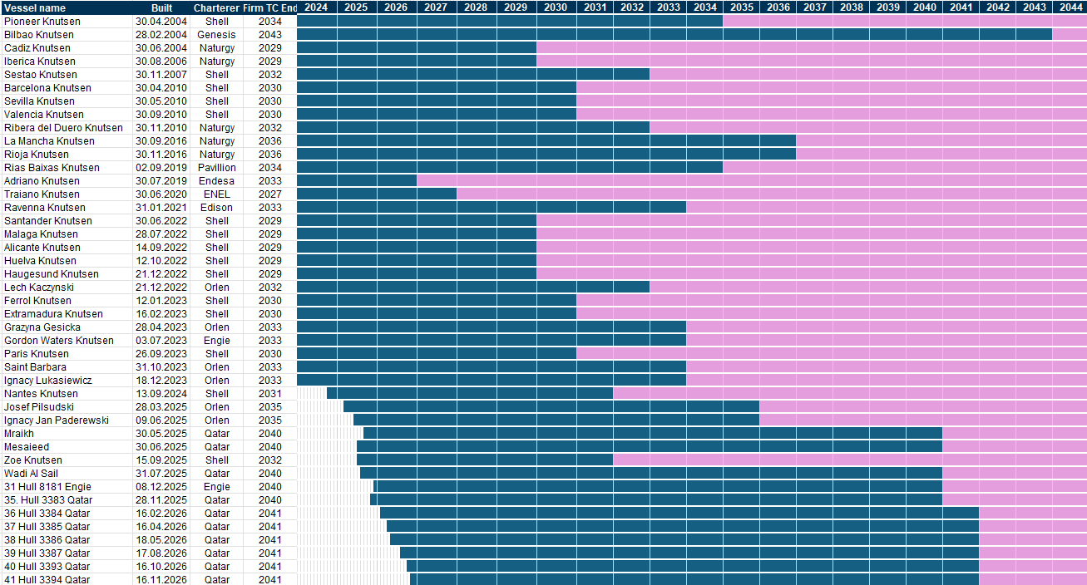
KNUTSEN LNG – LONG-TERM CONTRACTS

Slide 31
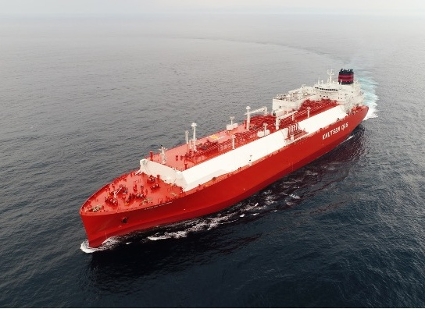
Strategic LNG/C development
Fuel savings
From steam propulsion to diesel electric to ME-GI/XDF
From HFO to triple fuel engines
Improved hull design: Speed Optimisation
Use of Hull Air lubrication system
Use of other energy saving equipment: hull appendages and solar cell
Increased focus on environment
Gas as fuel to reduce CO2 and NOx emissions
Minimize boil-off
LNG reliquefaction plant
Cargo operations optimisation, minimize GCU usage

Slide 32
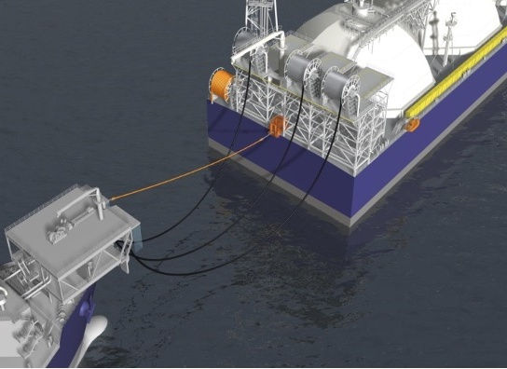
Strategic LNG/C development
Increased docking interval to 7.5 years
Rough Environment
North Atlantic trade
Arctic LNG
LNG FSRU: Conversion and Newbuildings
Matured projects and analysis
Ready for implementation: Steam vessels, TFDE’s and ME-GI
LNG/C Shuttle tankers, full design

Slide 33
Technology development
2ND GENERATION
LNG CARRIER
173,400 cbm:
Diesel- Electric
136 mt HFO eq./day
0,784 kg/cbm
Latest engine technology
at the time
Twin skeg – 2 propellers, increased efficiency
4 DFDE engines each vessel
Full flexibility of fuel and redundance
BOR 0,14
Delivered 2010
3RD GENERATION
LNG CARRIER
176,300-180,000 cbm:
ME-GI
100 mt HFO eq./day
0,567 kg/cbm
Latest engine technology
Optimised hull design
Shaft generator
(on some vessels)
Tank pressure build up allowance for cargo conditioning
BOR 0,08
Re-liquefaction plant
Full flexibility of fuel
Delivered in 2016 - 2020
NEW GENERATION
LNG CARRIER
174,000 cbm:
XDF or ME-GA, ALS
96 mt HFO eq./day
0,552 kg/cbm
In addition to 3rd generation:
Further hull Optimization
Air lubrication system giving less hull resistance
Shaft generator on all vessels
Simplified gas handling system (XDF)
Reduced investment cost
Delivered in 2022
1ST GENERATION
LNG CARRIER
138,000 cbm:
Steam Turbine
180 mt HFO eq./day
1,304 kg/cbm
“Traditional” LNG carrier
at the time
BOR 0,14
Delivered from 2004-2007
40% fuel reduction
28% fuel reduction
3% fuel reduction

Slide 34
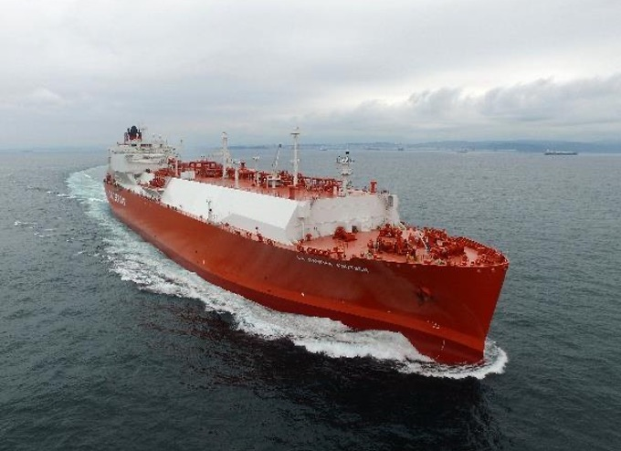
176.3 K CBM LNGC (ME-GI)
Fuel efficient and less environmental impact
Two Slow speed 7 Cylinder MAN Gas engines (MEGI)
Two 2,200 kw shaft generators
Four Auxiliary DF Hyundai Himsen Engines.
Redundant high pressure fuel gas supply system (Burckhart)
Gas Re-liquefaction plant based on N2 Compander system
Increased cargo discharge capacity
Shaft de-clutching and locking system.
Ballast water treatment system (KBAL)
Upgraded paint systems
Various minor upgrades

Slide 35
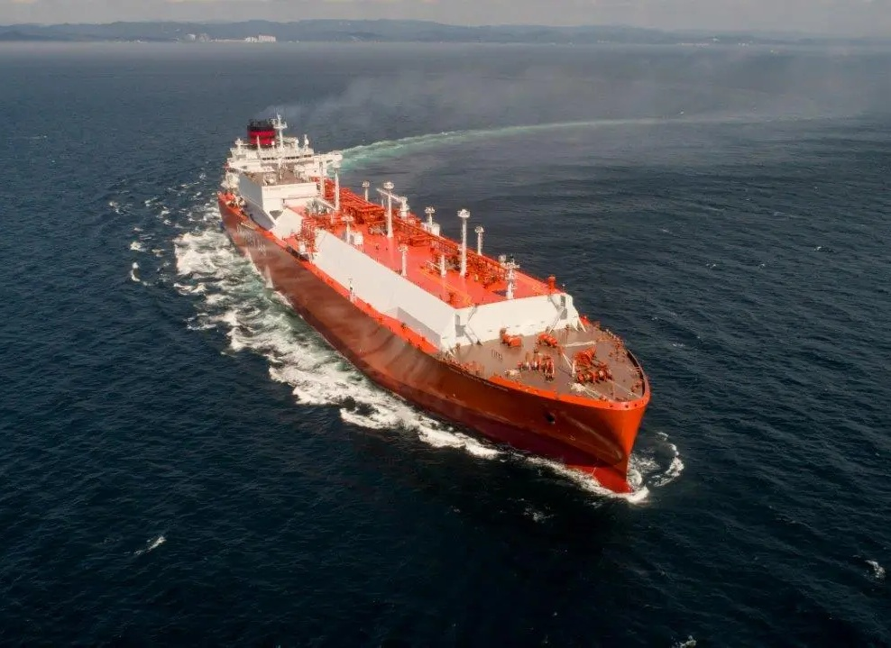
180 K CBM LNGC
(ME-GI)
Fuel efficient and less environmental impact
Optimised hull form
Two Slow speed 5 Cylinder MAN Gas engines (MEGI)
Four Auxiliary DF Engines.
Gas Re-liquefaction plant based on MR system
Increased cargo discharge capacity
Ballast water treatment system (KBAL)
Upgraded paint systems
LP SCR (NOx reduction)
Various minor upgrades

Slide 36
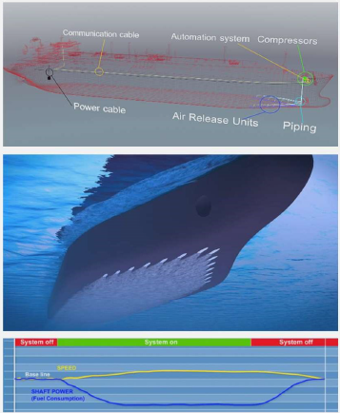
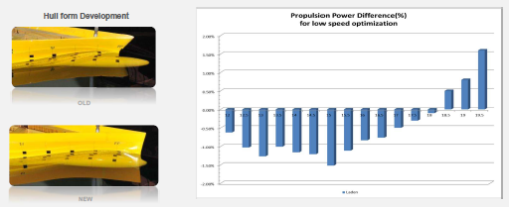
Latest LNG carrier
Safer
Mooring system
Pilot boarding
Lifeboat design
Anti collision system
Efficient
Air lubrication system
Shaft generator
Optimized hull
Increased filling limits
Greener
Less CO2 emissions
Less Methane emission

Slide 37
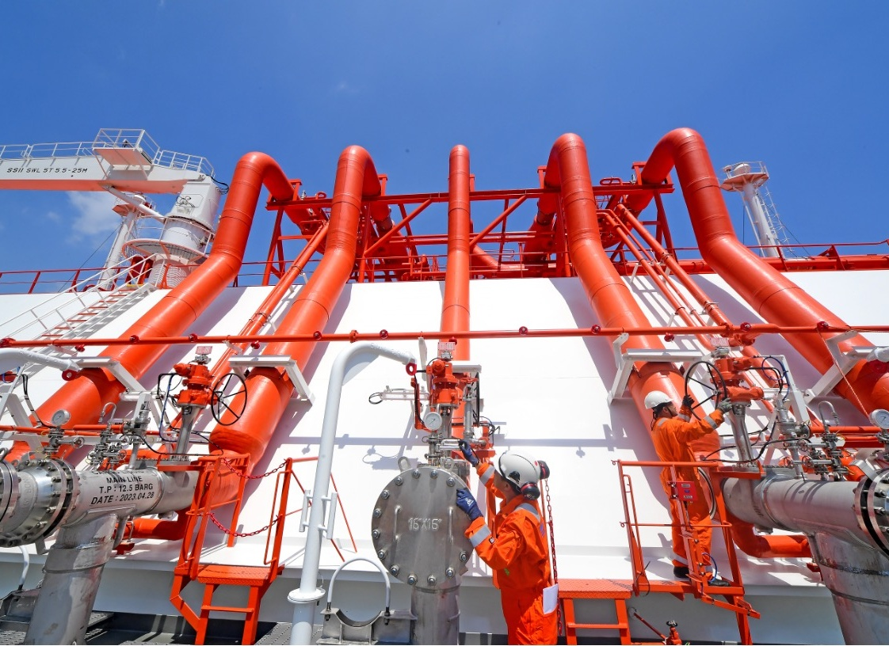
LNG Crew Training
Training centres in Norway, Spain, Philippines
Nautical and cargo handling simulators
Training based on:
  TCP requirements
  SIGTTO LNG competences
  Knutsen own additional matrix of courses based on our experience and requirements
  Specifically tailored training courses for each type of vessel, Reliquefaction plant, type of engines, main makers…
  Overlapping prior to promotion
Senior officers as superintendents in site teams in Shipyard well before delivery of the Vessel, attending inspection, commissioning and gas trials
200+ own contracted officers
Yearly, an average of 5% of the payroll is invested on training

Slide 38
Product / Chemical Tankers
Vessel | DWT | Delivered | Charterer
Eli Knutsen | 16 570 | 2009 | Total
Liv Knutsen | 16 570 | 2009 | Total
24 years continuous operation for Total in the same trade
Operating worldwide with long experience in North European trade. At present both vessels are on contract to Total and on bareboat charter with Algoma Tankers.
Vessels Ice Class 1A certified
Immingham
Amsterdam
Thames
Rotterdam
Antwerp
Le Havre
Bordeaux

Slide 39
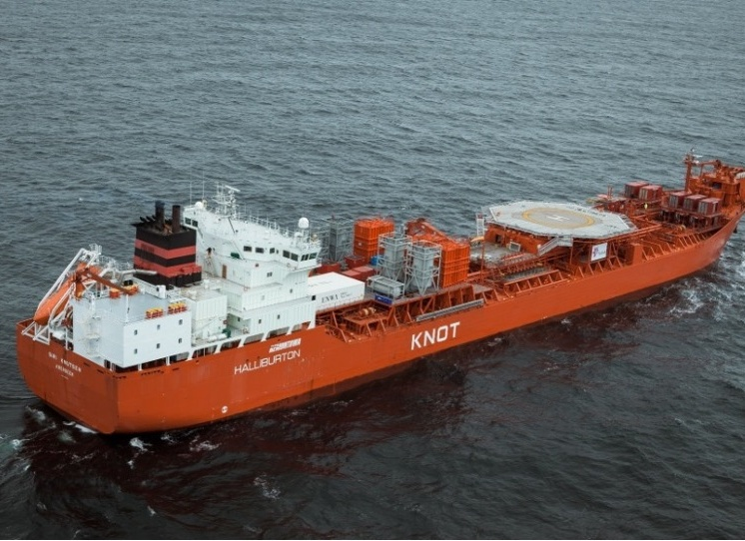
Knutsen Subsea Solutions
Technical innovation & focus areas
Well stimulation and chemical pumping vessels, EOR (Enhanced Oil Recovery)
Vessels for Extended Well Testing operation
Vessels for conversion to FSO, FPSO and Heavy Lift
Vessels for Wind Mill installation and Wind Mill Farm maintenance
LWI (Light Well Intervention):
  Injection of preservation fluids
  Reception of well clean-up fluids

Slide 40
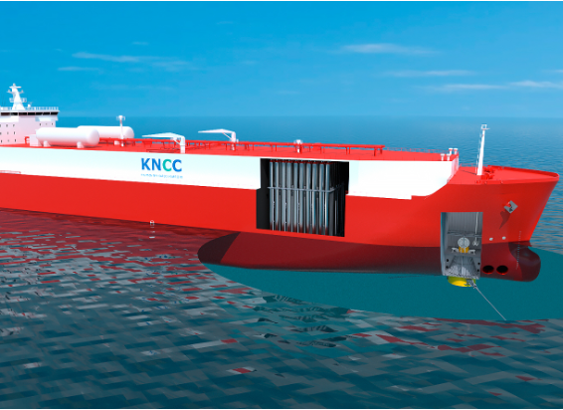
Knutsen NYK Carbon Carriers KNCC
•NYK and Knutsen Group joint venture company for the commercial development of a liquefied CO2 marine transportation and storage business worldwide using the Knutsen developed technology PCO2® which allows transport of liquified CO2 at ambient temperatures
•KNCC will provide customers with a unique competence and offer advanced transportation including liquefied CO2 loading and offloading onshore and offshore
•DNV GASA granted June 2023

Slide 41
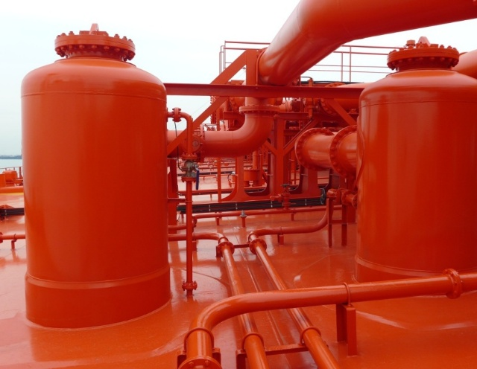
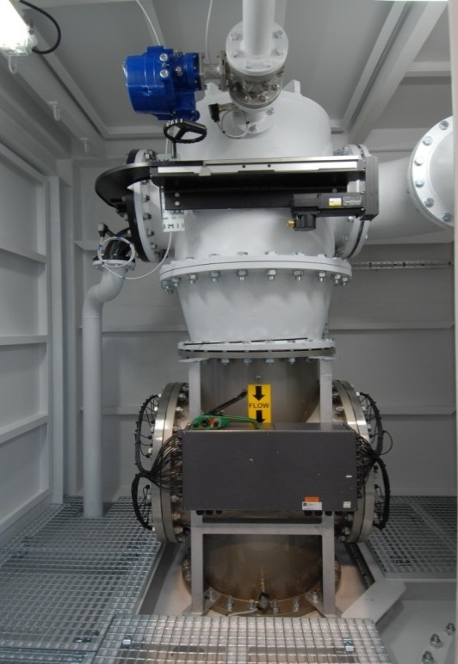
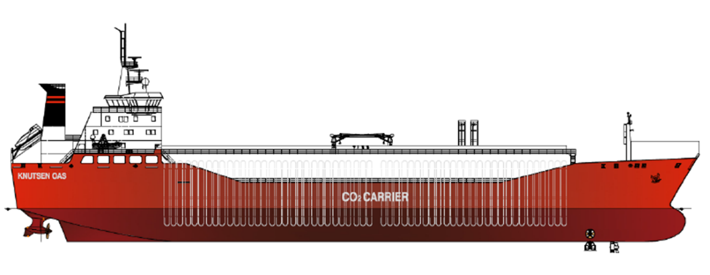
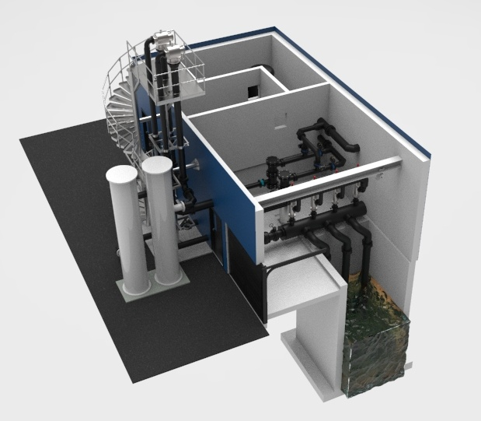
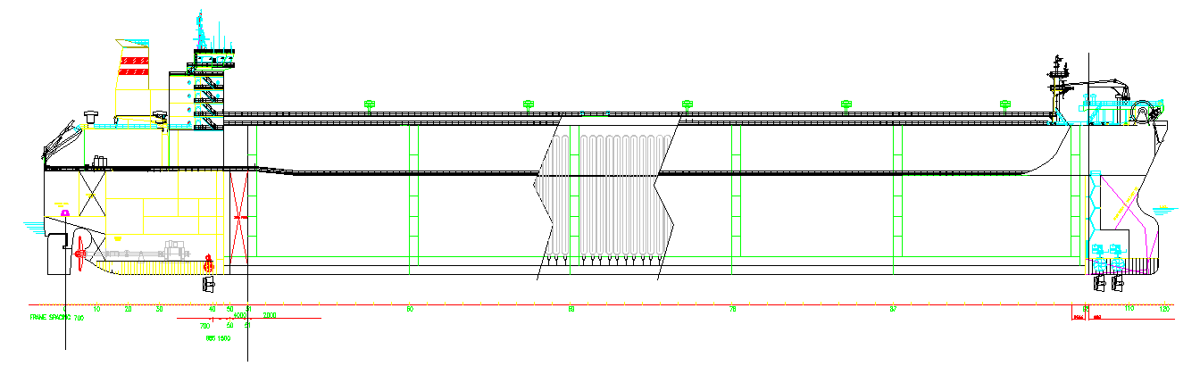
Owner of Advanced Technology
KVOC® - reducing VOC emissions
KBAL® - ballast water treatment
PNG® - marine CNG transportation
HTVP™- marine high TVP liquid transport
PCO2® - marine CO2 transportation
KO2 –removal of oxygen in water
Aquadrop - aquaculture water treatment
KVOC
KBAL
PCO₂
HTVP/PCO₂/PNG
AQUADROP

Slide 42
Modified KVOC system, KVOC 2
BLS
Gas released will build up pressure until all transfer can continue without gas release
P2 = P1 + H
p2
p2
Modified Inert Gas System
H
p1
Back pressure will be stable during the entire loading and maximum back pressure can be about 2 bar that will prevent any flash also in the BLS.
p1
p1
Knutsen Technology

Slide 43
Ballast water treatment, KBAL
KBAL features:
High volume flow (larger ships)
Treatment flexibility (intake, circulation
and discharge or combination)
Suitable for both retrofit and on new built ships
Cost efficient
No filter and no chemicals
27 in operation
Qualification status:
KBAL 600 M3/hr- 3.5 bar: IMO qualified. Certification from DNV.
KBAL 3000 M3/hr – 2.0 bar: IMO qualified.
Certification from DNV.
USCG/ Revised IMO: IMO revised G8 approved for KBAL Mark2 June 2020 and USCG November 2020.
One pass treatment IMO approved January 2023

